Slide 1
AMOS Demo Day Preparations
Prof. Dr. Dirk Riehle
Friedrich-Alexander University Erlangen-Nürnberg
AMOS H01
Licensed under CC BY 4.0 International
Notes:
It is Friedrich-Alexander University Erlangen-Nürnberg – FAU, in short.
Corporate identity wants us to say “Friedrich-Alexander University”.

Slide 2
The AMOS Demo Day
The demo day is the final day of the course
  The demo day is organized as a fair (“Messe”)
  Student teams show the results of their project
  Audience are industry partners and fellow students
After the opening, everything runs in parallel

Slide 3
AMOS Demo Day Time-Line
Time | Location | Agenda / Tasks
09:30-10:15 | Demo rooms | Set-up and test of demo room
10:15-10:25 | Plenum | Welcome address by Prof. Riehle
10:25-10:35 | Plenum | One slide presentation by each team
10:40-11:40 | Demo rooms | Four demo sessions of 15min. each
11:40-11:45 | Plenum | Closing remarks by Prof. Riehle
11:45-open | Demo rooms | Open discussion demo rooms

Slide 4
Presentation Booth / Demo Room
In “normal” times (not Corona crisis)
  Students are given a “demo booth”
  The booth is a table plus pinboards
  Students demo their work at this table
  Students explain their work using the posters
  Students can create additional materials
In times of the Corona crisis
  Students are given a virtual demo room
  Students provide a back-up video
  Students demo their work in this room
  Students explain their work using slides
  Students can create additional materials

Slide 5
Two Posters for Each Team
In “normal” times (not Corona crisis)
  One product management poster with
    Project and team name, team logo
    Short project description
    Key use cases
  One software development poster with
    Software architecture
    Employed technology
    Tooling and processes
In times of the Corona crisis
  Create a slide deck with
    One product management slide
    One software development slide
  Content like in normal times
    But landscape, not portrait format

Slide 6
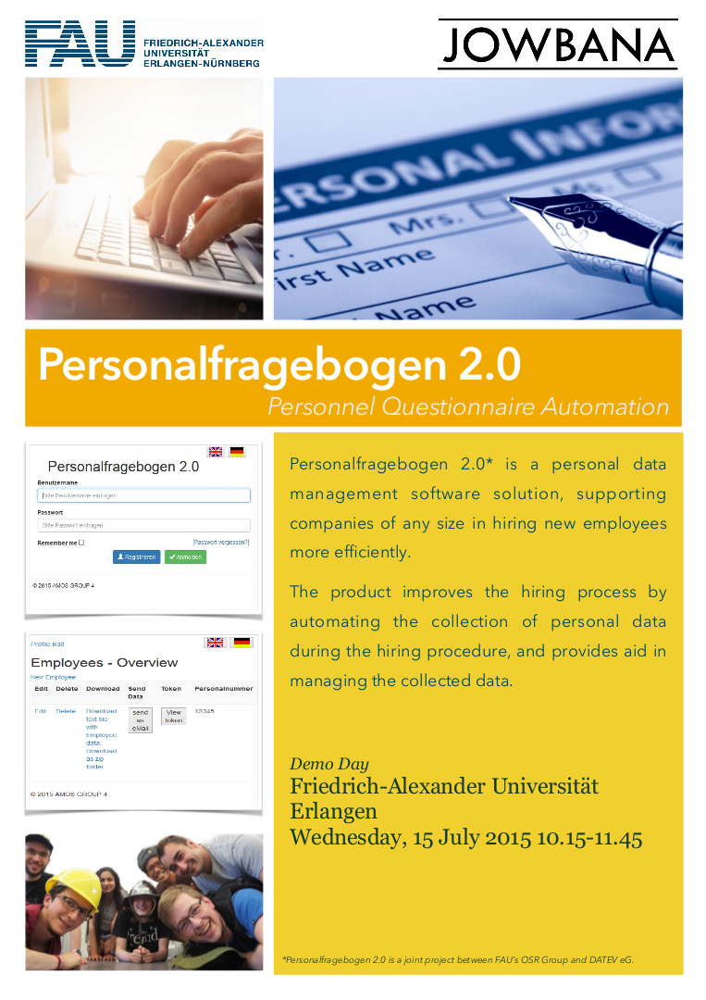
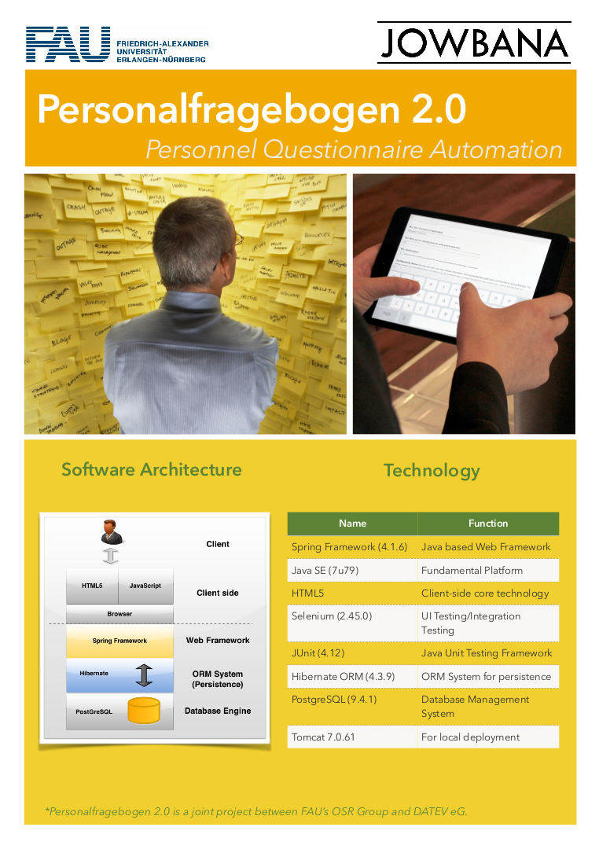

Slide 7
Use of Corporate Identities
Please use FAU logo
Please use your team logo
Please use industry partner logo, but ask first

Slide 8

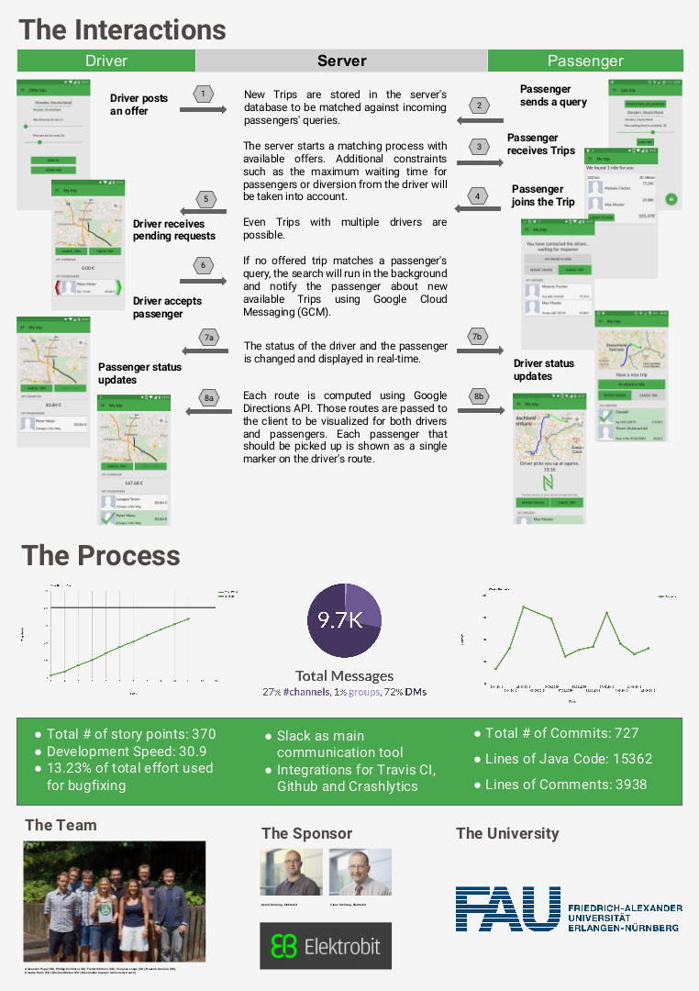

Slide 9
Presentation Table
In “normal” times (not Corona crisis)
  Mandatory
    Bring a laptop to demo your project
    Bring anything else necessary
  Optional
    Be creative, do what works!
    The goal is to explain your project
In times of the Corona crisis
  Prepare for online presentation

Slide 10
Demo Preparation
Dos
  Have a clean user interface
  Use domain terminology and examples
    In the user interface (labels, titles)
    In the stories you tell
  Have a story to tell, for example,
    A day in the life of …
    A workflow example
  Make the demo (data) re-entrant
    You will have to start over several times
    Always want to start at the same point
Don’ts
  Use “test” or “help” as labels
  Not follow the advice on the left

Slide 11
Demo Execution
Have two people at the presentation booth / virtual demo room
  One talks to people in general
  One demos to people

Slide 12
Thank you! Questions?
dirk.riehle@fau.de – http://osr.cs.fau.de
dirk@riehle.org – http://dirkriehle.com – @dirkriehle
DR

Slide 13
Credits and License
Original version
  © 2012-2020 Dirk Riehle, some rights reserved
  Licensed under Creative Commons Attribution 4.0 International License
Contributions
  ...

